Slide 1
Python Libraries for Data Science

Slide 2
Overview
Numpy
Pandas
Matplotlib
Scikit-learn
StatsModels
Seaborn
Autoviz
Keras
PyTorch
TensorFlow

Slide 3
Features of NumPy
Provides fast, precompiled functions for numerical routines.
Array-oriented computing for better efficiency.
Supports an object-oriented approach.
Compact and faster computations with vectorization.
Extensively used in data analysis.
Creates powerful N-dimensional array.
NumPy is primarily written in C and C++ to enable super-fast computation, as C & C++ is a machine-level languages.

Slide 4
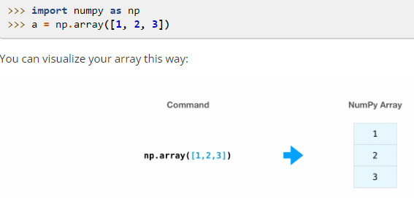
Code example

Slide 5
Features of pandas
Pandas library is used able to work with a large selection of IO tools such as CSV, JSON, SQL, BigQuery, and Excel files.
Pandas have two main objects that it works with: Pandas Series and Dataframes.
It has methods to perform functions such as object creation, viewing data, selection of data, analyzing missing data, operations such as merge, grouping, reshaping, time series, categorical values, and plotting.
It uses general data wrangling and data cleaning.
Contains high-level data structures and manipulation tools.

Slide 6
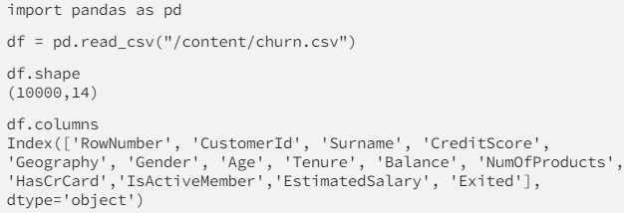
Code example

Slide 7
Features of Matplotlib
Enables a wide variety of visualizations such as line plots, subplots, images, histograms, paths, bar charts, pie charts, tables, scatter plots, filled curves, log plots, data handling, and stream plots.
Images and visualizations can be exported to multiple file formats.
Low memory consumption and better runtime behavior.
It can be embedded in various IDEs as well as Jupyter Lab, and Graphical User Interfaces.

Slide 8
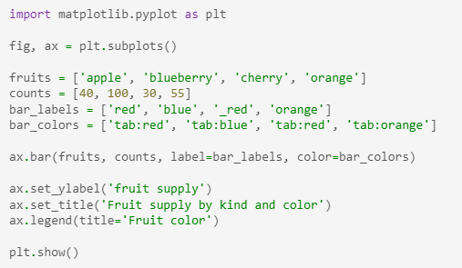
Code example

Slide 9
Features of Seaborn
It has plots such as relational plots, categorical plots, distribution plots, regression plots, matrix plots, multi-plot grids.
Seaborn is able to plot linear regression models and statistical time series and works well with NumPy as well as Pandas data structures.
It is also fast at visualizing univariate and bivariate data.
Seaborn is simply faster as a visualization tool we can pass the entire data, and seaborn does a lot of the work.

Slide 10
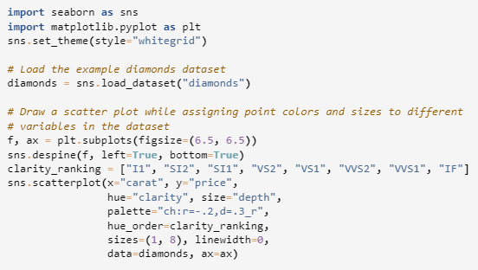
Code example

Slide 11
Features of Autoviz
Autoviz is able to analyze the dataset and make recommendations on how to clean your variables.
It is able to detect missing values, mixed data types, and rare categories and can help speed up data-cleaning activities.
Can be a part of MLOps pipelines and form word clouds.
Autoviz is considerably fast in creating visualizations.

Slide 12
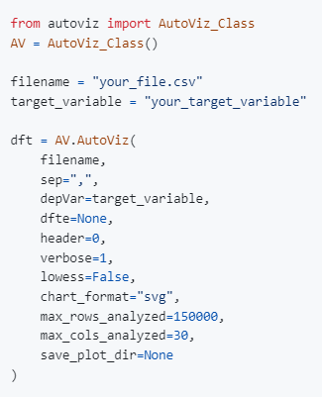
Code example

Slide 13
Features of Scikit-learn
It supports predictive data analytics applications such as classification, regression, clustering, dimensionality reduction, model selection, pre-processing, etc.
Scikit-learn supports algorithms such as logistic regression, decision trees, bagging, boosting, random forest, and Support Vector Machine (SVM), along with a whole host of classification metrics as well.
Scikit-learn is one of the most used packages for machine learning packages and is a great toolkit to work with modeling.

Slide 14
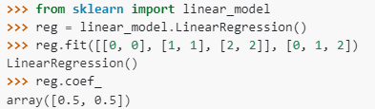
Code example

Slide 15
Features of Statmodels
Statsmodels has many features, including:
Linear regression models.
Generalized linear models.
Time series analysis.
Multivariate statistics.
Nonparametric methods.
Robust statistical methods.
Visualization tools.

Slide 16
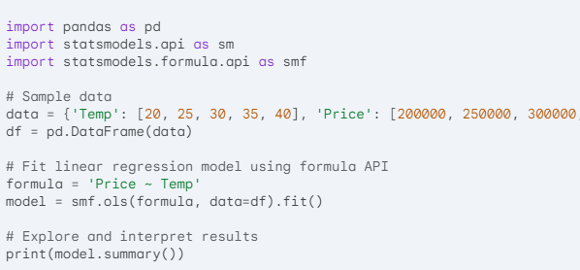
Code example

Slide 17
Features of Tensorflow
Tensorflow is used to prepare data, build DL models, deploy models and implement MLOps.
Models are easy to build with Tensorflow using the high-level Keras API.
Tensorflow can be deployed on the web, on mobile and edge, and on servers.
Tensorflow enables ease of use via pre-trained models, research with state-of-the-art models, and helps build your own models.
Tensorflow is scalable, enables easy debugging, has extensive scalable architectural support, and has fantastic library management support.
Tensorflow enables Robust DL Production.

Slide 18
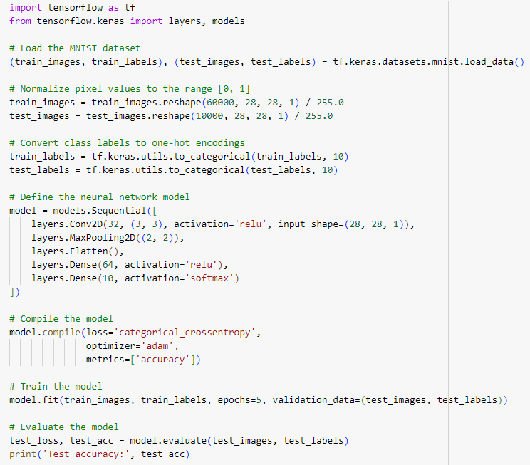
Code example

Slide 19
Features of Keras
Keras is simple, flexible, and powerful, and Keras is able to run experiments quickly and efficiently.
Keras is built on top of Tensorflow 2 and can scale to large settings for production quality outputs.
Keras can be deployed anywhere, such as websites, phones with Android, iOS, embedded devices, and even as a web API.
Pre-trained models are especially helpful in applications such as image recognition, where we use models such as Xception, ResNet, MobileNet, ImageNet, etc.
It is easy to use and is one of the best ways to get into deep learning.
Keras has multiple GPUs as well as TPU support

Slide 20
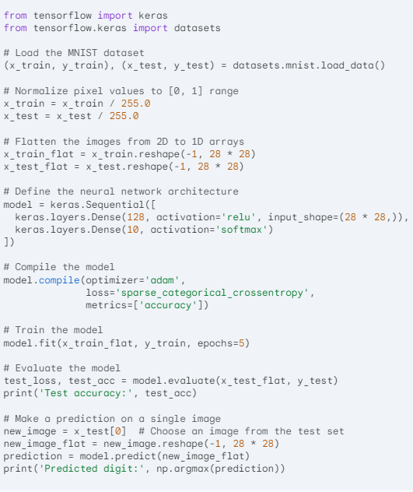
Code example

Slide 21
Features of Pytorch
PyTorch is built from the ground up to be production ready. There are easy tools to deploy the models in a way that is cloud agnostic.
Supports features such as metrics, logging, multi-model serving, and the creation of RESTful endpoints.
Training for the model can be done in a distributed fashion & has a robust ecosystem.
There are applications for deep learning – PyTorch in computer vision, natural language processing, and even reinforcement learning.
It has support for CPU as well as GPU and can scale very well.

Slide 22
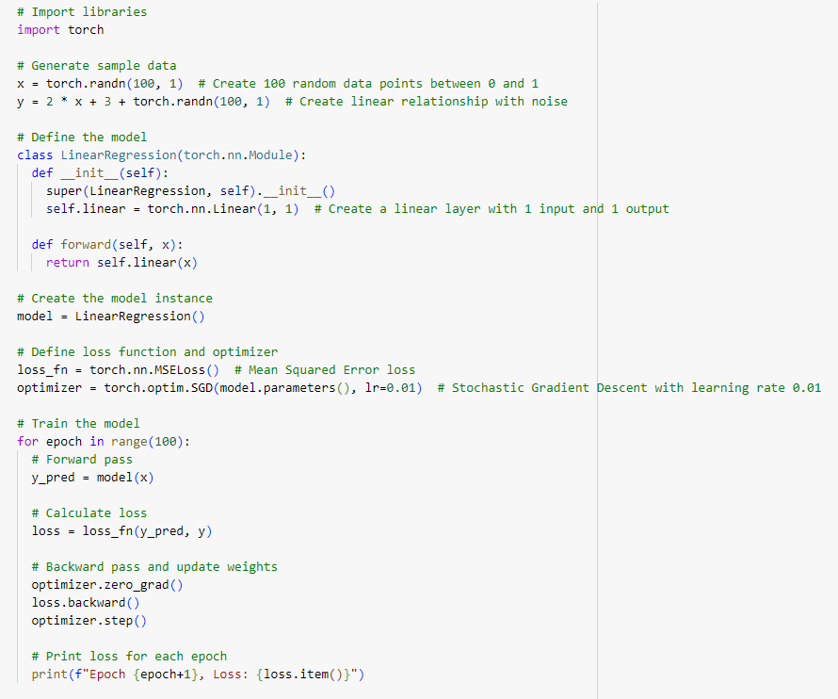
Code example

